Slide 1
Clinical Presentation Initial Episode
60 year-old African American female
Presented with pruritic pink papules and nodules, some with dusky and necrotic pinpoint centers
Distribution: Neck, upper trunk, upper extremities
There was sparing of the palms, soles, and oral mucosa
Eruption occurred 12-24 hours after receiving Shingrix and Influenza vaccination
What’s your diagnosis?

Slide 2
Neutrophilic Dermatosis Secondary to Inactivated polio and Hepatitis b vaccination Missouri dermatological society Case of the Month
Saniya Shaikh, D.O. – PGY-3
Sofia Chaudhry, M.D.
Nicole Burkemper, M.D.

Slide 3
Clinical Presentation Initial Episode
60 year-old African American female
Presented with pruritic pink papules and nodules, some with dusky and necrotic pinpoint centers
Distribution: Neck, upper trunk, upper extremities
There was sparing of the palms, soles, and oral mucosa
Eruption occurred 12-24 hours after receiving Shingrix and Influenza vaccination
PMHx: IgA lambda Multiple Myeloma s/p autologous peripheral blood stem cell transplant one year prior to presentation
Consistently normal FLC and SPEP since transplant
On Ixazomib (Ninlaro) for two months prior to presentation due to high-risk cytogenetics

Slide 4
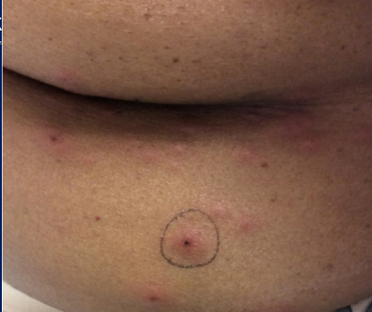
Clinical Presentation Second Episode
Patient presented eight months later for a similar eruption
She reported one week of pruritic, pink, edematous plaques and nodules
Distribution: started on the torso, then spread to the face and neck
The eruption occurred 24 to 48 hours after receiving an Inactivated Polio and Recombinant Hepatitis B vaccination

Slide 5
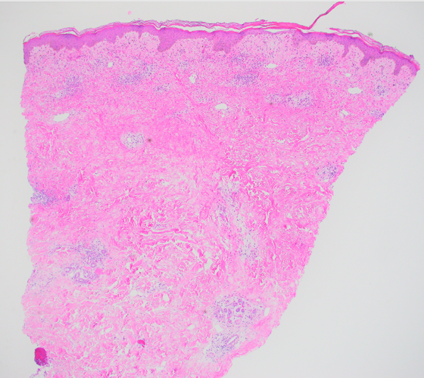
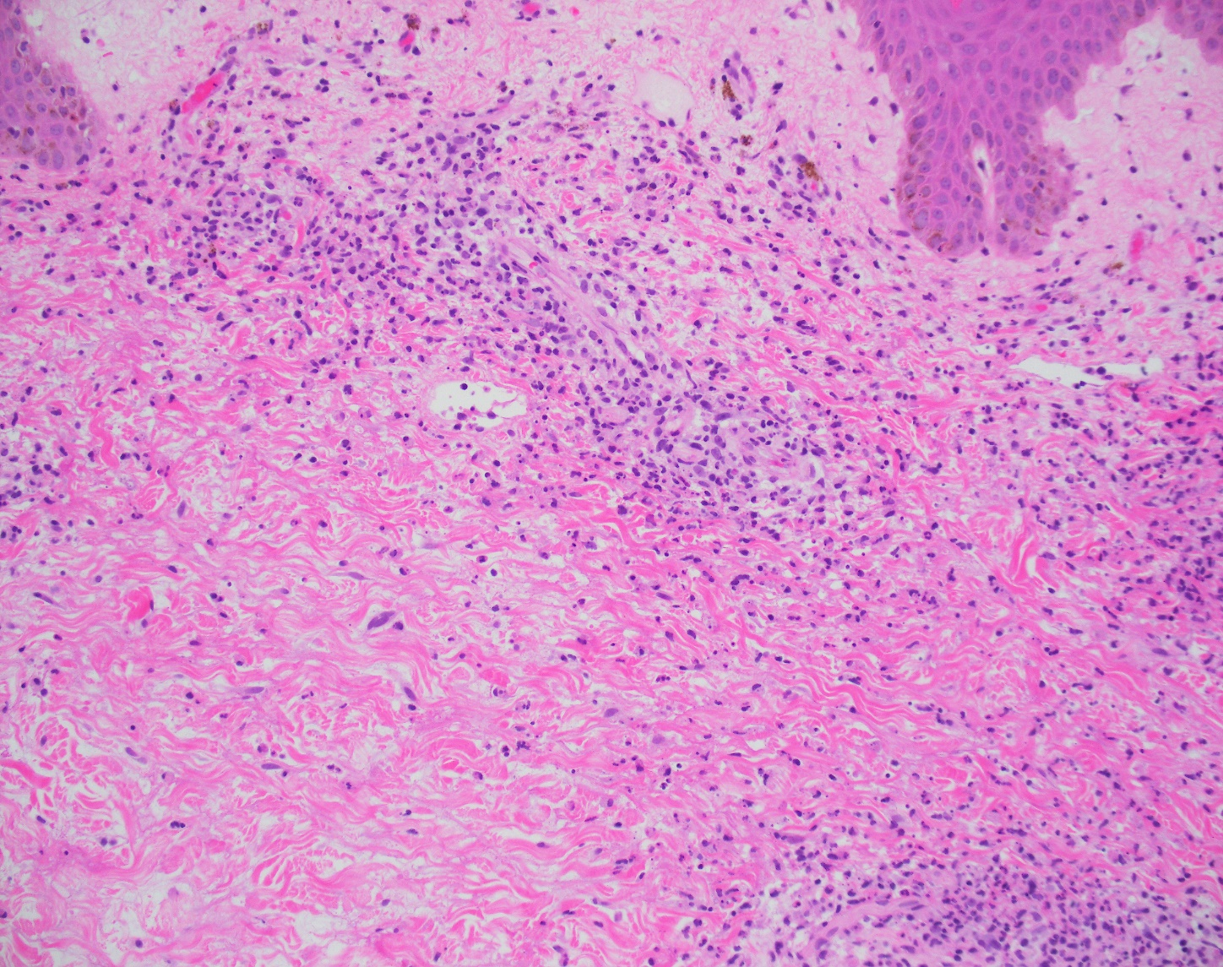
Skin biopsies were completed at the initial and subsequent presentation.
The biopsies showed superficial and deep neutrophilic infiltrate with leukocytoclasis and papillary dermal edema, consistent with a neutrophilic dermatosis.

Slide 6
Discussion
Diagnosis: Acute neutrophilic dermatosis, clinically consistent with Sweet syndrome, likely secondary to inactivated polio and/or recombinant hepatitis B vaccines.
Treatment: Both episodes of the patient’s eruptions resolved at one-week follow up with oral prednisone (starting at 60mg QD, tapered by 10mg every three days) and medium potency topical corticosteroid use BID PRN, respectively.
Given onset of rash soon after vaccine administration, quick resolution after treatment, and lack of recurrence after these episodes, vaccine-associated neutrophilic dermatosis was favored.

Slide 7
Discussion, continued
Rare case reports have previously linked Sweet syndrome with a history of pneumococcal, influenza, and BCG vaccination.^{1,2}
Onset within 12 hours to 15 days after vaccination
Treated with Prednisone (60 mg/d), resolution within 7 to 10 days.
Additionally, there have been rare reports of leukocytoclastic vasculitis with Hepatitis B vaccination.
However, our case is the first to our knowledge to report a link between Sweet’s syndrome and concurrent Inactivated Polio and recombinant Hepatitis B vaccinations.

Slide 8
references
1. Jovanović M, Poljacki M, Vujanović L, Duran V. Acute febrile neutrophilic dermatosis (Sweet's syndrome) after influenza vaccination. J Am Acad Dermatol. 2005;52(2):367-369. doi:10.1016/j.jaad.2004.07.061.
2. Pedrosa AF, Morais P, Nogueira A, Pardal J, Azevedo F. Sweet's syndrome triggered by pneumococcal vaccination. Cutan Ocul Toxicol. 2013;32(3):260-261. doi:10.3109/15569527.2012.759960.

Slide 9
Questions
1) Which of the following is the best treatment choice for vaccine-induced Sweet syndrome? A. Indomethacin B. Clofazimine C. Potassium iodide D. Systemic corticosteroids E. Colchicine
2) Which of the following vaccines have NOT shown a link to the appearance of Sweet syndrome? A. Pneumococcal B. MMR C. Influenza D. BCG E. Both A and C

