Slide 1
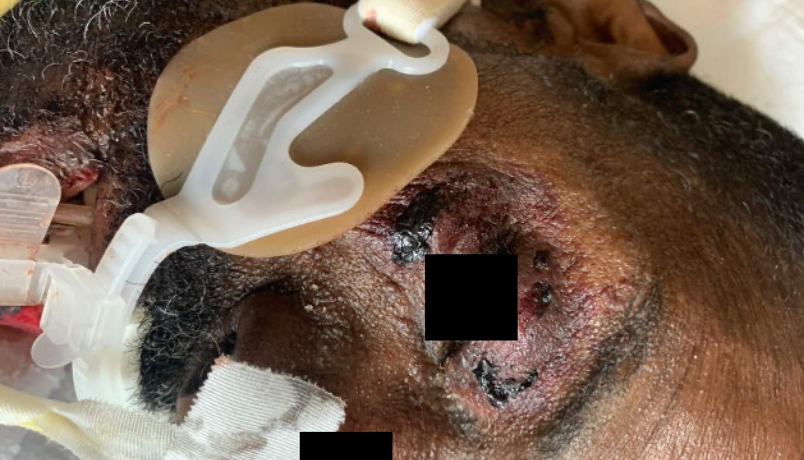
June Case of the Month
Day 1: Patient presented to OSH with lower extremity swelling and dyspnea
Only known PMH were HTN and DM2
BNP and troponins were elevated🡪 heart failure treatment initiated
Day 2: While inpatient, had stroke-like symptoms
CT done which showed MCA occlusive thrombus, requiring immediate IR-guided thrombectomy
After the procedure, bruising of the eyelids were noted.
Originally thought to be secondary to taping eyelids shut during the procedure.
Day 3: primary team noted “tongue and lip swelling, bruising of bilateral eyelids, and lip desquamation”
🡪 Dermatology was consulted
What is your diagnosis?

Slide 2
May Case of the Month
Dr. Alison Huber, MD
Dr. Emily Smith, MD

Slide 3
Case presentation - 49yo M
Day 1: presents with CHF symptoms
Day 1: Patient presented to OSH with lower extremity swelling and dyspnea
Only known PMH were HTN and DM2
BNP and troponins were elevated🡪 heart failure treatment initiated
Day 2: While inpatient, had stroke-like symptoms
CT done which showed MCA occlusive thrombus, requiring immediate IR-guided thrombectomy
After the procedure, bruising of the eyelids were noted.
Originally thought to be secondary to taping eyelids shut during the procedure.
Day 3: primary team noted “tongue and lip swelling, bruising of bilateral eyelids, and lip desquamation”
🡪 Dermatology was consulted
Day 2: stroke-like symptoms
Day 3: glosittis, skin friability 🡪 dermatology consult

Slide 4
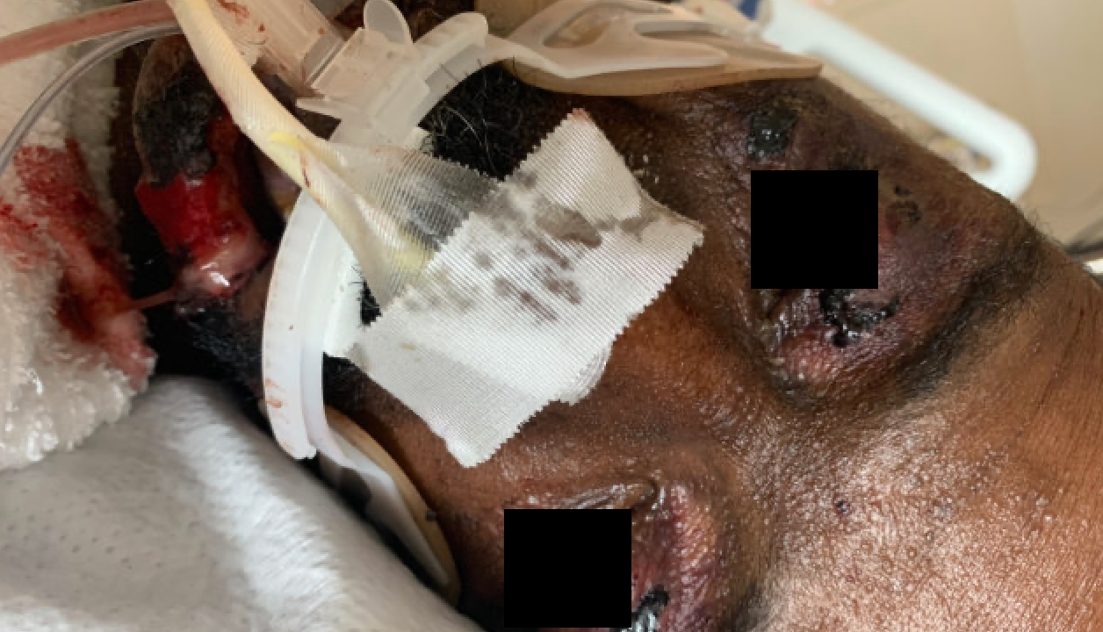
Dermatology Consulted
Physical exam noted:
bilateral periorbital hemorrhage, hemorrhagic stomatitis, and glossitis
Biopsy of tongue and lip performed
Differential at this time included:
Systemic amyloidosis due to concern for the classic “pinch purpura” (periorbital purpura)
trauma from eyelid/lip taping
steroid-induced skin atrophy

Slide 5
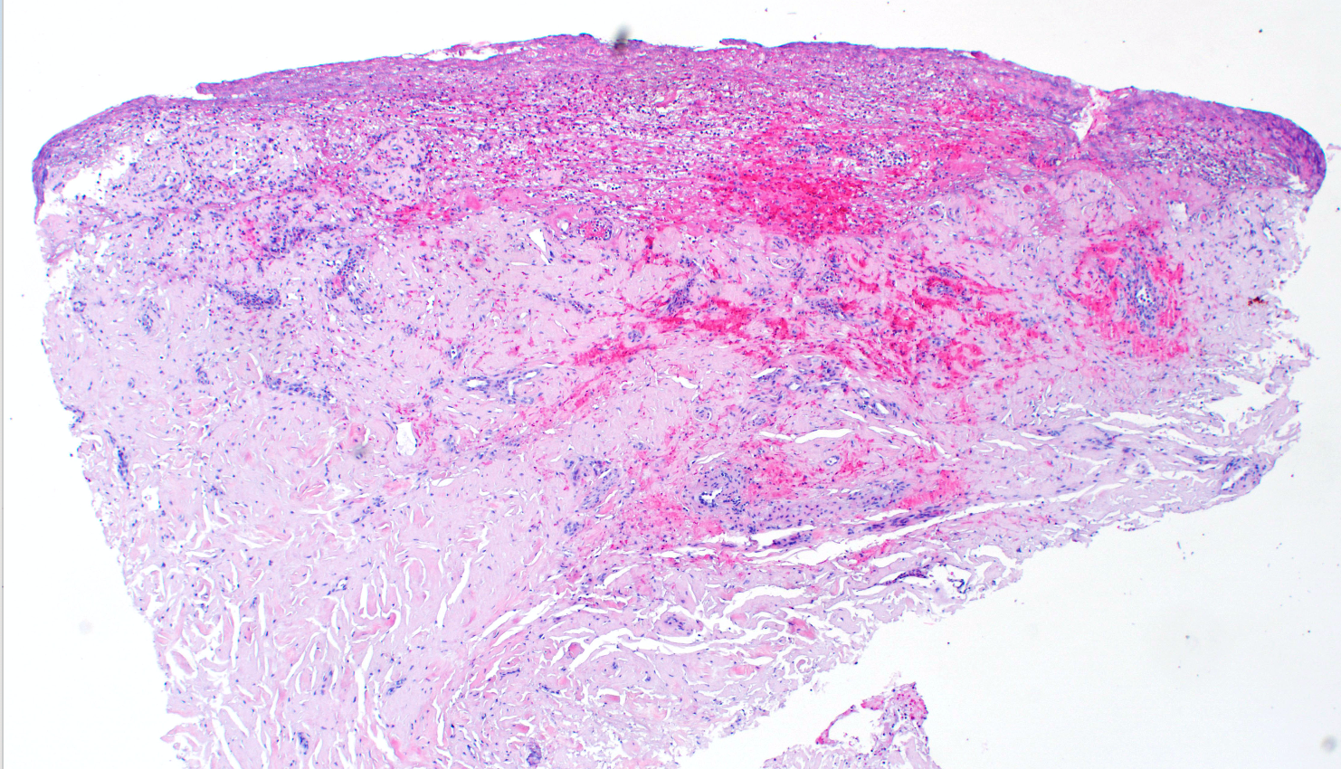
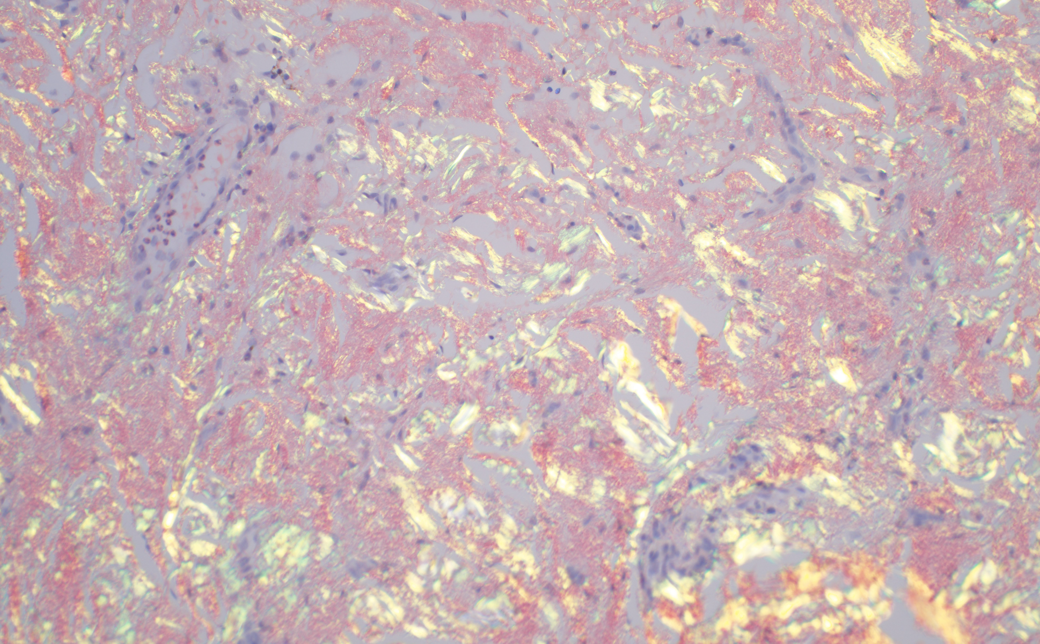
Biopsy Results
Biopsy of the tongue and lip noted:
Amorphous pink, cracked material suggestive of amyloidosis.
Congo Red stain was performed on lip biopsy and was markedly positive for amyloid deposits

Slide 6
Further Work-Up
Echo was done to rule out PFO as cause for stroke as well as to diagnose heart failure
findings were suggestive of amyloidosis.
Dermatology work up:
SPEP
UPEP
UA
free light chains
recommended hematology/oncology consult

Slide 7
FINAL DIAGNOSIS
UA showed marked proteinuria.
SPEP and UPEP were within normal limits
Free light chains:
Kappa: 1.13 mg/dL (normal limit: .33-1.94mg/dL)
Lambda: 59.3 mg/dL (normal limit: .57-2.63 mg/dL)
Diagnosed with systemic AL amyloidosis

Slide 8
Question 1 - https://bit.ly/3wGzFea
In regard to amyloidosis, which parameter is most closely linked to worse prognosis?
A. Severity of macroglossia
B. Liver involvement
C. Extent of cardiac involvement
D. Nephrotic range proteinuria

Slide 9
Question 2 - https://bit.ly/3wGzFea
The process demonstrated in the two pathology specimens is due to which of the following?
A. Deposition of improperly folded ﬁbril proteins
B. Calcium pyrophosphate crystal deposition
C. Increased collagen production
D. Microscopic thromboemboli

