Slide 1
Case of the Month January
University of Missouri, Dept of Dermatology
J. Keith Parker MD
Emily Smith MD

Slide 2
January Case of the Month
HPI
55 y/o male was concerned about a changing spot on his upper back.
Noted after a severe sunburn, despite sunscreen application.
His only medication was omeprazole.
PMH
History of melanoma of unknown primary (metastatic to the right parietal scalp, TxN1cM0)
History of squamous cell carcinoma of the left parietal scalp (metastatic to the left cervical nodes, TisN3bM0) status-post radiation therapy
Physical exam
He displayed confluent photodistributed erythema of his upper torso, where a dark brown irregularly pigmented papule was identified. On dermoscopy, a reticular network and asymmetric focus of irregular darker brown/purple blotches were observed.
A shave removal was performed.

Slide 3
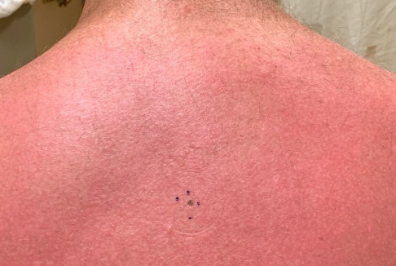
Atypical pigmented lesion

Slide 4
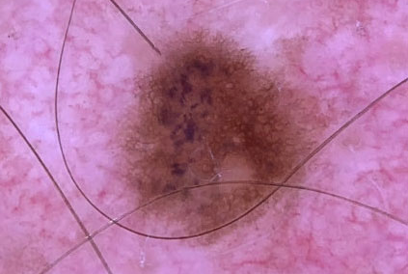
Dermoscopy

Slide 5
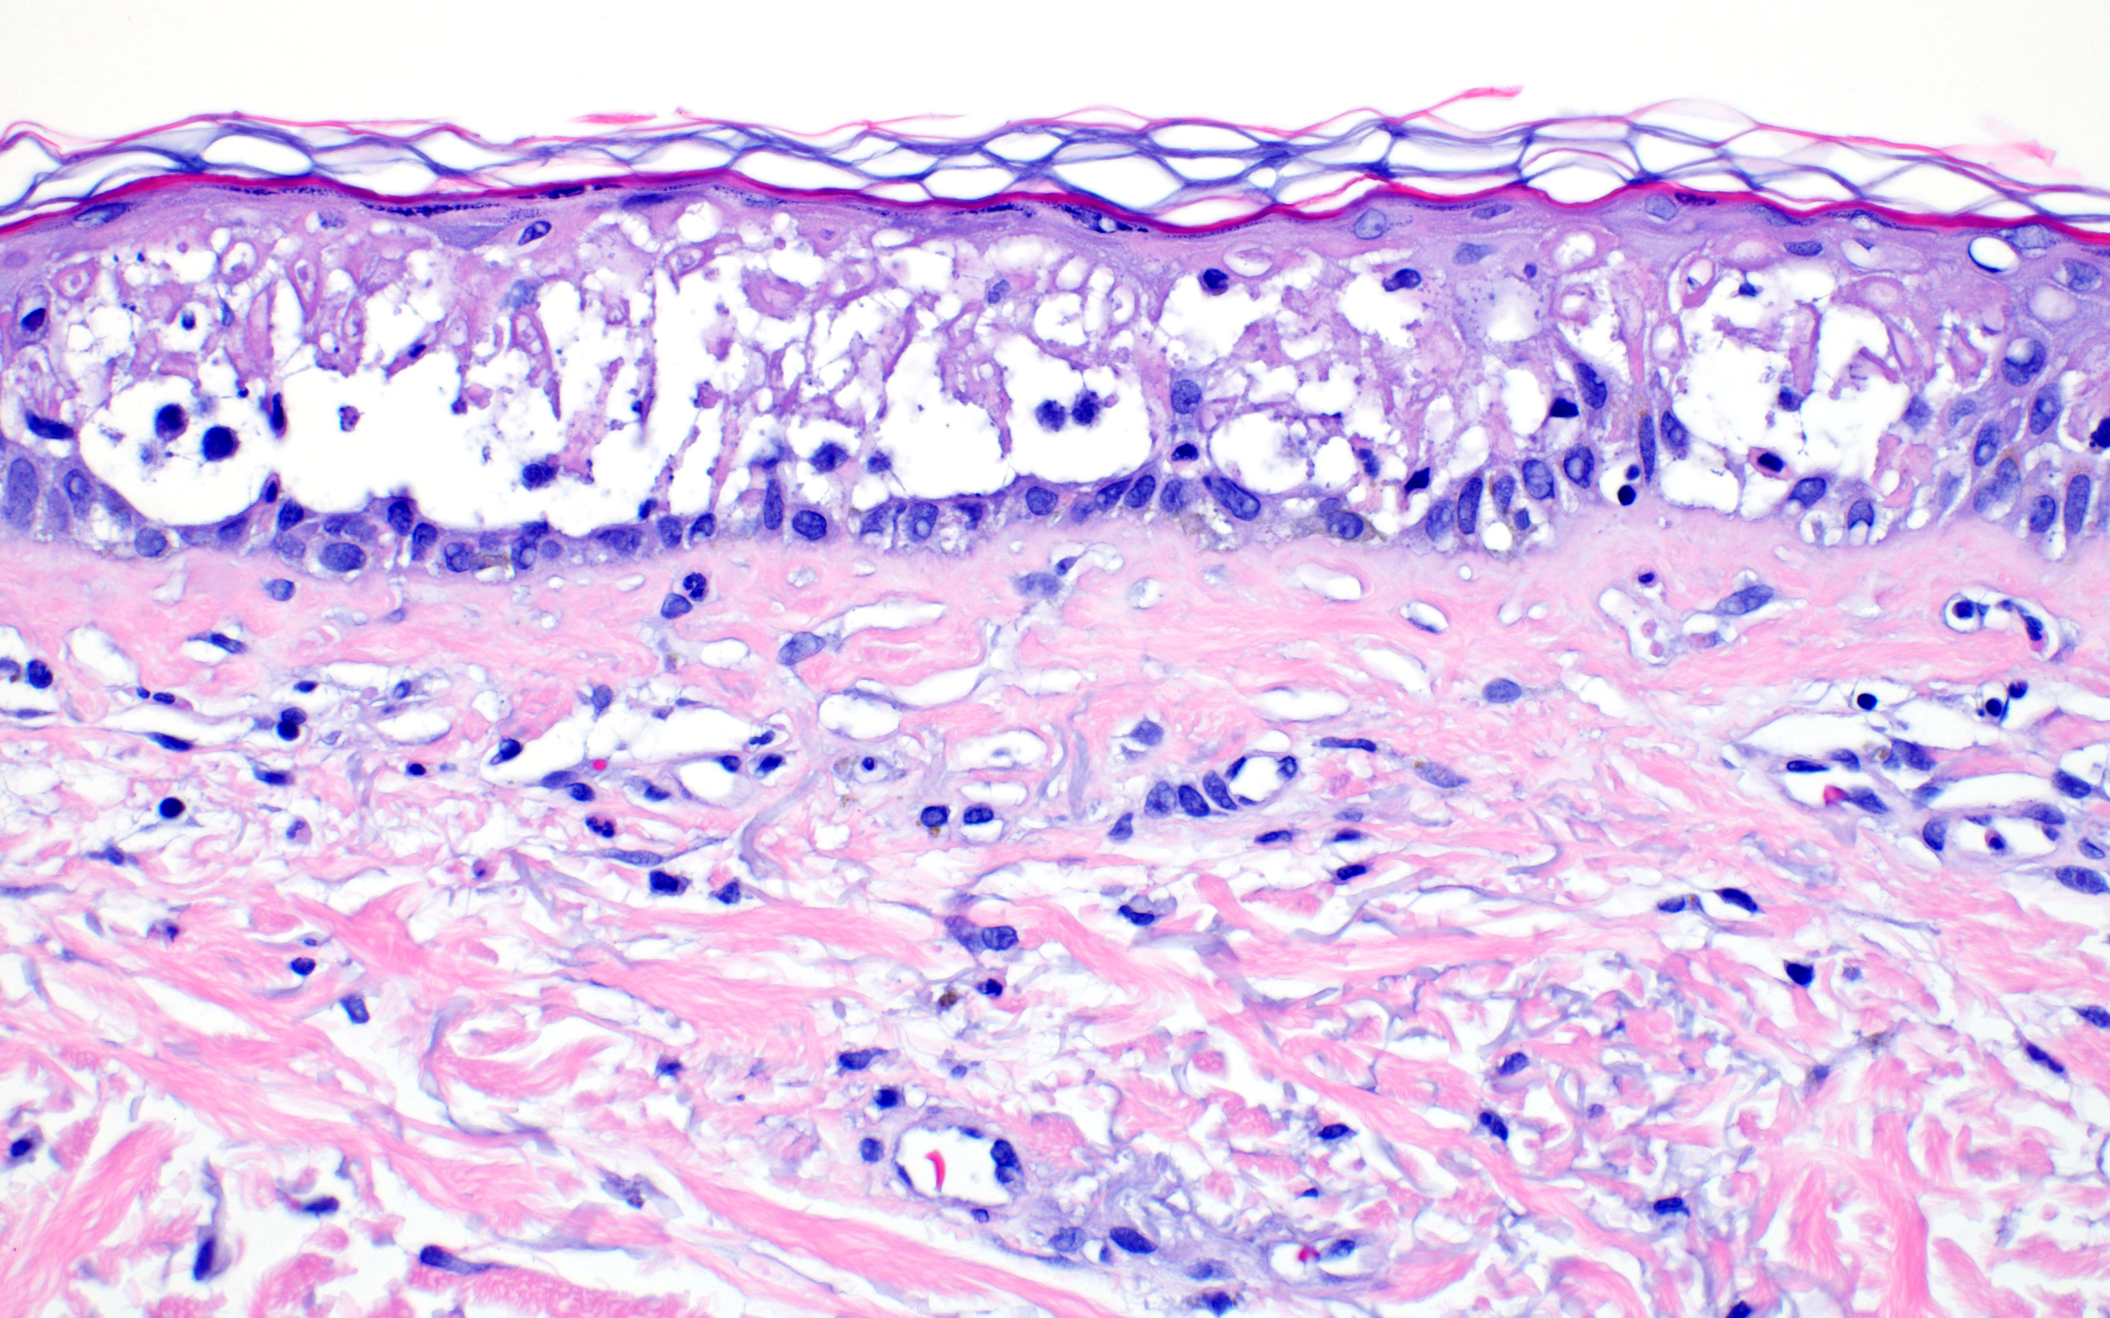
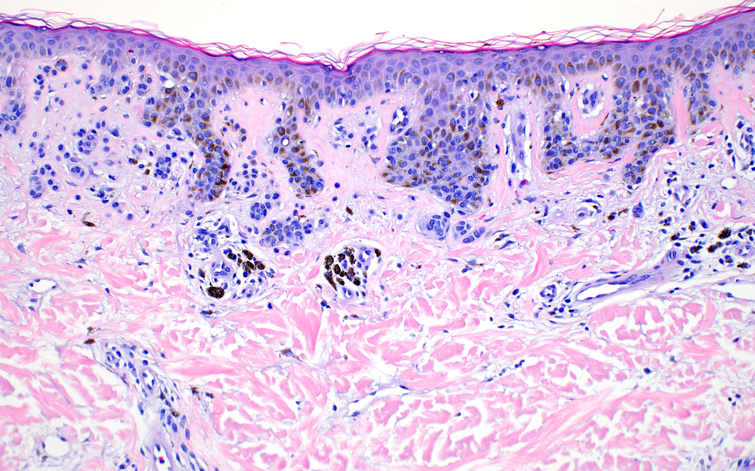

Slide 6
Question 1 (Link to survey: http://bit.ly/3bMHMyB)
Which of the following is the most likely diagnosis given the clinical history, physical exam, and histopathological findings
Compound melanocytic nevus with changes consistent with recent sunburn
Compound melanocytic nevus with drug-induced phototoxic reaction
Compound melanocytic nevus with spongiotic dermatitis likely secondary to allergic contact dermatitis from sunscreen
Evolving melanoma-in-situ

Slide 7
Question 2 (Link to survey: http://bit.ly/3bMHMyB)
Which of the following is the most appropriate next step
Discontinuation of omeprazole
Excision with 5 mm margins
Reassurance
Patch testing to evaluate for allergy to sunscreen components

