Slide 1
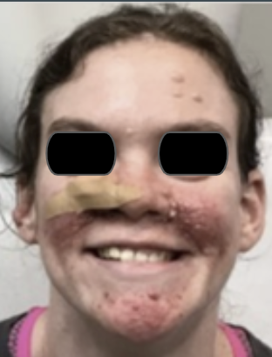
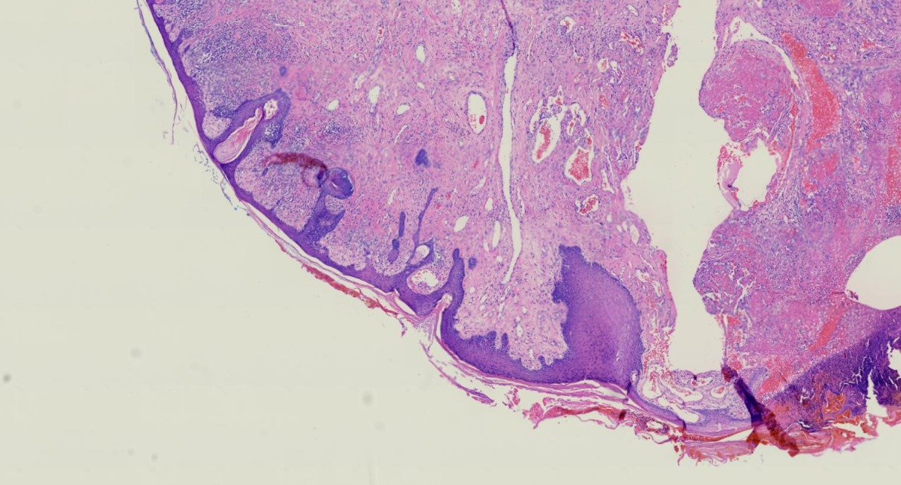
March Case of the Month
26-year-old female with a new large, pedunculated, friable, tan-brown, polyp on the right nasal ala
PMH:
Tuberous sclerosis
Seizures
Multiple angiofibromas
Histology
Increased number of venules throughout the dermis along with an associated proliferation of fibrocytes, many of them multinucleate. Perifollicular fibrosis was not noted.
What is your diagnosis?

Slide 2
Multinucleate cell angiohistiocytoma in a patient with tuberous sclerosis
Elizabeth Demaree, D.O.¹; Chelsea Schwartz, D.O.²; Nathan Cleaver, D.O.³
Northeast Regional Medical Center, Kirksville, MO
LECOM at Seton Hill, Greensburg, PA
Cleaver Medical Group, Cumming, GA

Slide 3
Our patient
A 26-year-old female, with a PMH of tuberous sclerosis and seizures, presented to the dermatology clinic complaining of “growths” on her cheeks for two weeks.
The lesions have bled and have not been previously treated. On physical exam, multiple angiofibromas were noted. A large, pedunculated, friable, tan-brown, polyp on the right nasal ala was also identified and biopsied.
Histologically, the lesion revealed an increased number of venules throughout the dermis along with an associated proliferation of fibrocytes, many of them multinucleate. Perifollicular fibrosis was not noted.
Due to presence of 4/4 histologic criterion, a diagnosis of multinucleate cell angiohistiocytoma (MCA) was made.
To our knowledge, MCA has never been reported in a patient with tuberous sclerosis, but is likely coincidental.

Slide 4
Discussion of multinucleate cell angiohistiocytoma (MCA)
Multinucleate cell angiohistiocytoma is a rare and underrecognized lesion first reported in 1985, with less than 150 cases reported since then (1-4).
MCA typically presents in middle-aged to elderly women with a striking female predominance of 3:1 (3).
Presents clinically as asymptomatic, 2-15 mm well-defined unilateral sparse grouped papules, red-brown to violaceous in color.
The clinical differential diagnoses include generalized eruptive histiocytosis, eruptive microvenular hemangioma, Kaposi’s sarcoma, dermatofibroma, papular granuloma annulare, and papular sarcoidosis (2,3).
They are usually localized to the dorsum of the hands (38.7%) and lower extremities (24.2%) but have been reported on the trunk and mucosa (1,2,4,11).
MCA presents in most cases (especially if solitary) without associated systemic disease.
If generalized, there is no gender predilection, and possible association with: Castleman’s disease, POEMS syndrome, vitiligo with anti-thyroid antibodies, and anti-Ro 60 antibodies (3,7), and hepatitis C with cirrhosis (3,4)

Slide 5
Pathogenesis of multinucleate cell angiohistiocytoma (MCA)
The pathogenesis of MCA remains unknown but is likely a reactive process (1,3).
Frew et al. described an inflammatory and vascular origin with fibrosis involved in the progression of the disease (9).
Several reports have hypothesized an inflammatory response with intravascular macrophage migration and the role of mast cells interacting with Factor XIII+ mononuclear dendritic cells leading to the production of multinucleated cells and promotion of secondary vascular hyperplasia (2,4,10).
Overexpression of estrogen has been exhibited in lesions, which could explain the highly vascular nature and female predominance secondary to the angiogenic effects of estrogen signaling (2).
Due to the location of lesions, trauma, such as insect bites, may play a role in the pathogenesis as well (11,12,13).

Slide 6
Treatment of multinucleate cell angiohistiocytoma (MCA)
There is no standard of care for treatment of MCA and treatment is not necessary, but many options are available for patients seeking removal of lesions (7).
Edgerton et al. reported successful treatment of lesions using a potassium-titanyl-phosphate laser (KTP) combined with triamcinolone acetonide injections for two sessions ten weeks apart.
KTP lasers reduce blood vessels and reduce vascular proliferation in MCA (2).
Tuchayi et al. reported successful treatment using a fractionated ablative carbon dioxide laser followed by triamcinolone injections, which improved color and flattening of lesions.
Carbon dioxide lasers remodel fibrous stroma and ablate vessels leading to rapid re-epithelialization (9).
Other treatment options available are surgical excision, cryotherapy, argon lasers, and intense pulsed light (2).
For generalized MCA, there is no treatment, but a trial of thalidomide 50 mg bid has been reported with improvement after 5 months (3).

Slide 7
References
Rato M, Monteiro AF, Parente J, Aranha J. Case for diagnosis. Multinucleated cell angiohistiocytoma. Anais Brasileiros de Dermatologia. 2018;93(2):291-293. doi:10.1590/abd1806-4841.20186821 (1)
Edgerton B, Ladha MA, Hunter C, Devani AR, Prajapati VH. Successful treatment of multinucleate cell angiohistiocytoma in an adult male patient with potassium-titanyl-phosphate laser in combination with intralesional corticosteroids. JAAD Case Rep. 2019;5(10):880-882. Published 2019 Oct 22. doi:10.1016/j.jdcr.2019.08.001 (3)
Wang, M., Abdul‐fattah, B., Wang, C., Zhao, Y., Qu, X., Al‐Muriesh, M., Wang, X., Zhu, L., Qian, Y., Huang, C. and Chen, S. (2017), Generalized multinucleate cell angiohistiocytoma: case report and literature review. J Cutan Pathol, 44: 125-134. doi:10.1111/cup.12853 (2)
Roy SF, Dong D, Myung P, McNiff JM. Multinucleate cell angiohistiocytoma: A clinicopathologic study of 62 cases and proposed diagnostic criteria. J Cutan Pathol. 2019;46(8):563-569. doi:10.1111/cup.13463 (12)
Nguyen AH, Glembocki DJ, Patel NB. Multinucleate cell angiohistiocytoma. Cutis. 2017;100(6):429-431. (14)
Frew JW. Multinucleate cell angiohistiocytoma: clinicopathological correlation of 142 cases with insights into etiology and pathogenesis. Am J Dermatopathol. 2015;37(3):222-228. doi:10.1097/DAD.0000000000000075 (16)
Grgurich, E, Quinn, K, Oram, C, McClain, R, Lountzis, N. Multinucleate cell angiohistiocytoma: Case report and literature review. J Cutan Pathol. 2019; 46: 59– 61. https://doi.org/10.1111/cup.13361 (5)
Hake S. Cutaneous manifestations of tuberous sclerosis. Ochsner J. 2010;10(3):200-204. (18)
Moradi Tuchayi S, Garibyan L, Lee KC. Successful treatment of multinucleate cell angiohistiocytoma with fractionated ablative CO₂ laser. JAAD Case Rep. 2019;5(4):297-299. Published 2019 Mar 25. doi:10.1016/j.jdcr.2019.01.004 (4)
Suh, J‐H, Lee, S‐K, Kim, H‐Y, Kim, M‐S, Lee, U‐H. A case of multinucleate cell angiohistiocytoma in a 14‐year‐old boy showing two different clinical and histopathological findings. J Cutan Pathol. 2019; 46: 221– 225. https://doi.org/10.1111/cup.13398 (7)
Doane JA, Purdy K, Pasternak S. Generalized Multinucleate Cell Angiohistiocytoma. J Cutan Med Surg. 2015;19(3):323-325. doi:10.2310/7750.2014.14129 (6)
Pérez LP, Zulaica A, Rodríguez L, et al. Multinucleate cell angiohistiocytoma. Report of five cases. J Cutan Pathol. 2006;33(5):349-352. doi:10.1111/j.0303-6987.2006.00428.x (9)
Coco V, Guerriero C, Stefani AD, Pennacchia I, Peris K. Linear and Bilateral Multinucleated Cell Angiohistiocytoma (MCAH). Journal of Dermatological Case Reports. 2017;10(4). doi:10.3315/jdcr.2016.1237 (10)
Smolle J, Auboeck L, Gogg-Retzer I, Soyer HP, Kerl H. Multinucleate cell angiohistiocytoma: a clinicopathological, immunohistochemical and ultrastructural study. Br J Dermatol. 1989;121(1):113-121. doi:10.1111/j.1365-2133.1989.tb01407.x (11)

